Slide 2


Analysis of FPAs in the LHC RB circuit
Christoph Obermair, TE-MPE-CB Lukas Felsberger, TE-MPE-MI Franz Pernkopf, TU-Graz Andrea Apollonio, TE-MPE-CB Daniel Wollmann, TE-MPE-CB

Slide 3
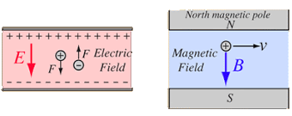
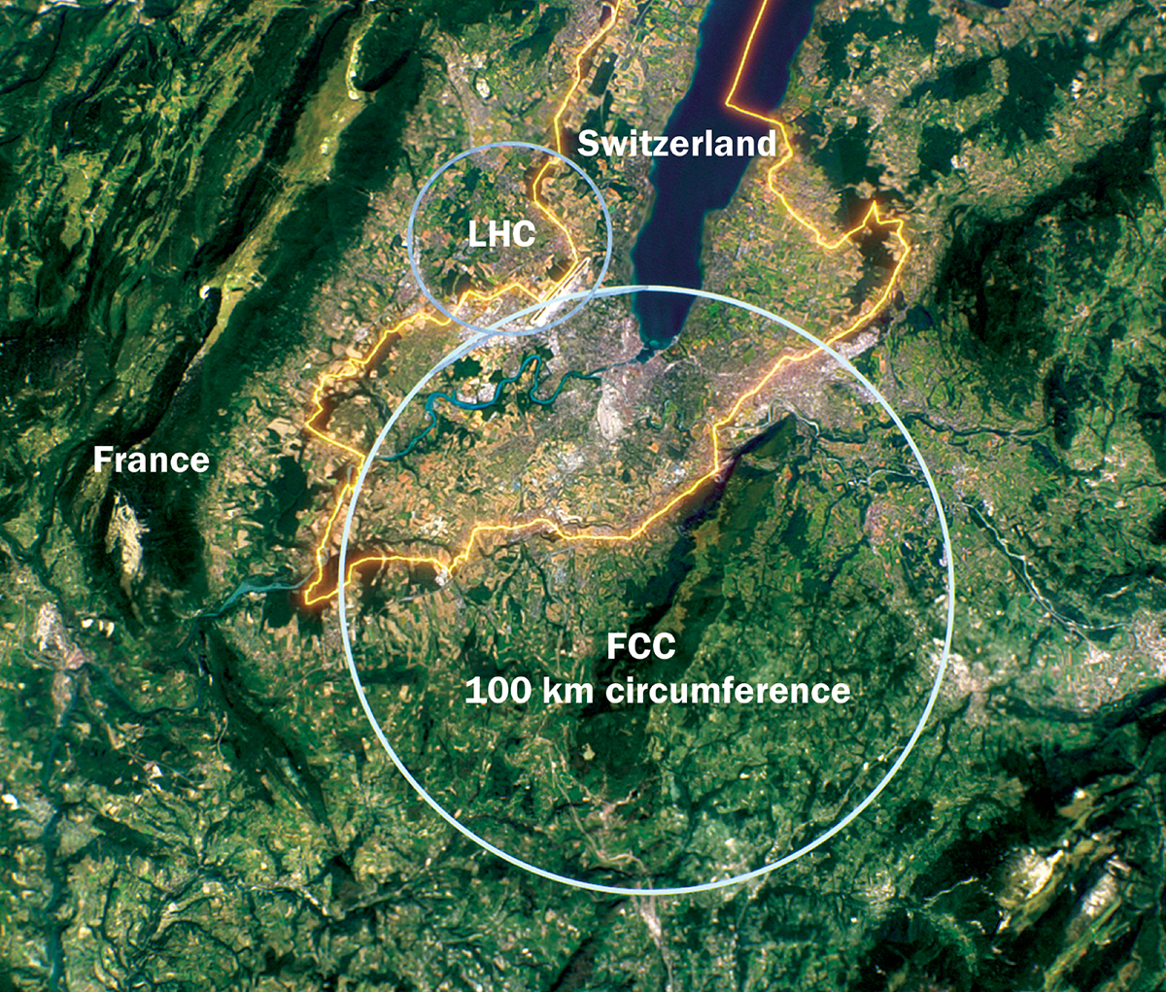
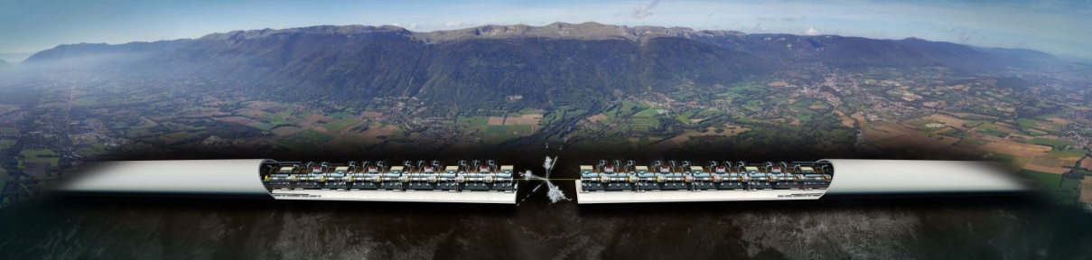
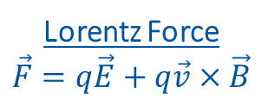
Introduction to Accelerators
Principle: Accelerate particles with electric field, and analyze collissions with target.
Types:
Linear accelerators - Linear accelerator 4 (Linac4)
Limitation to high collission energy is electric field
Breakdowns can destry radio frequency cavities
Circular accelerators - Large Hadron Collider (LHC)
Limitation to high collission energy is electric field
Quenches can destroy magnets
Current LHC status: LHC page 1
Lorentz Force
$$\vec{F}=q\vec{E}+q\vec{v}×\vec{B}$$
CLIC concept image

Slide 4
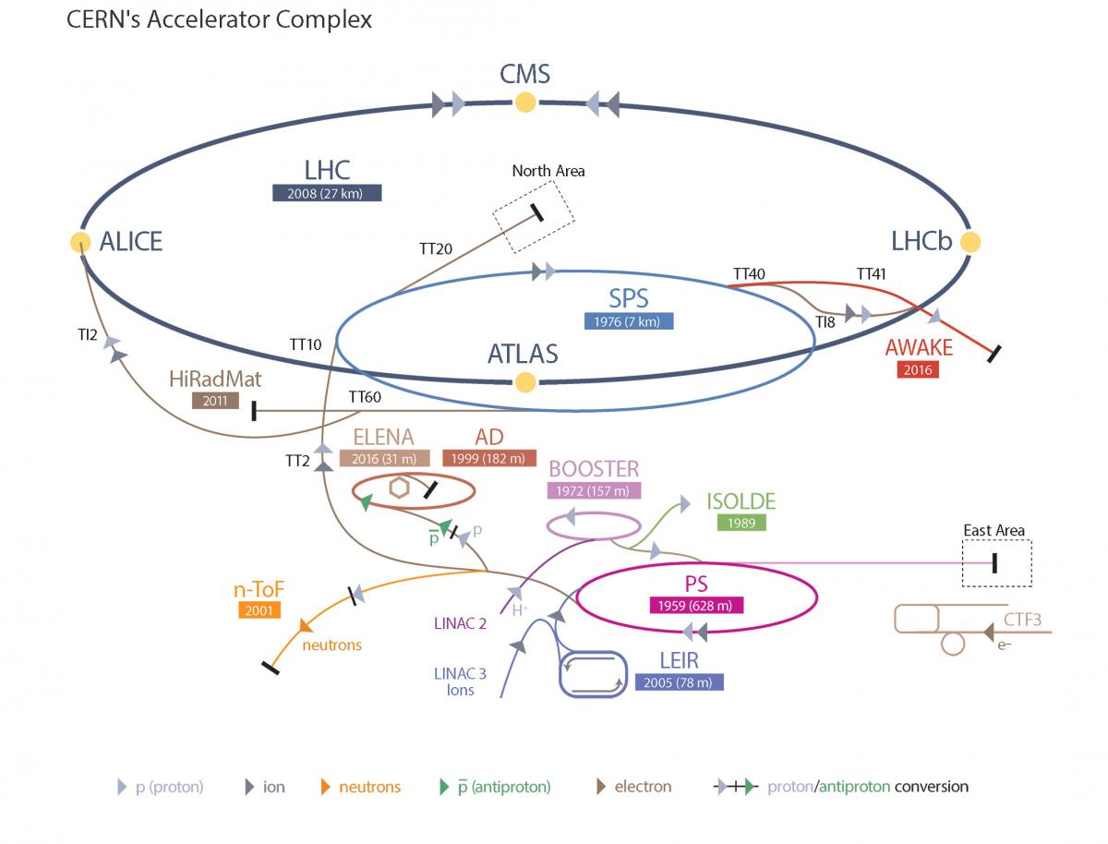
Large Hadron Collider - LHC
LHC Facts
Cost of the LHC | 4332 MCHF
Length | 26 659 m
Dipole operating temperature | -271.3°C
Cost per magnet | ~ 1 MCHF
Number of main dipoles | 1232
Power consumtion | 1.3 TWh/a
Number of circuits | 8
Stored energy per circuit | 1.1 GJ (380-ton TGV @ 50km/h)
11/2/2022

Slide 5
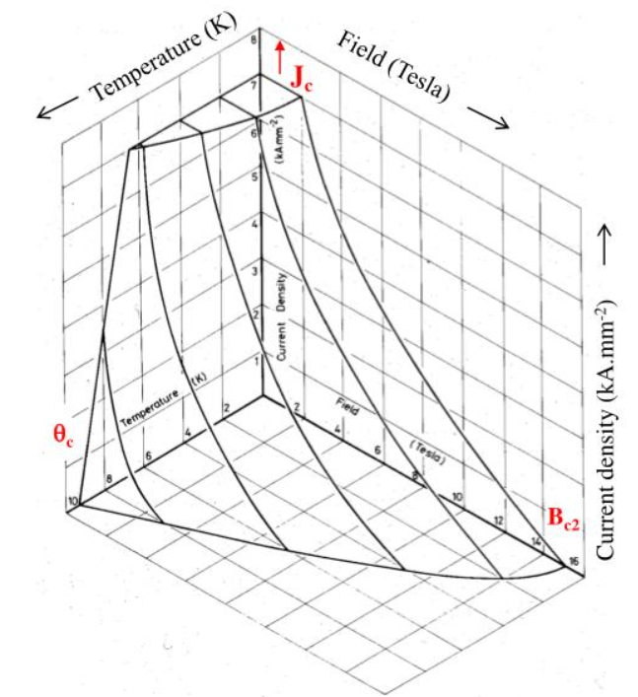
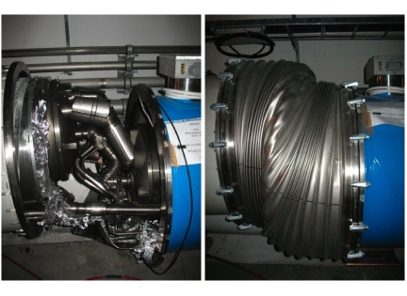
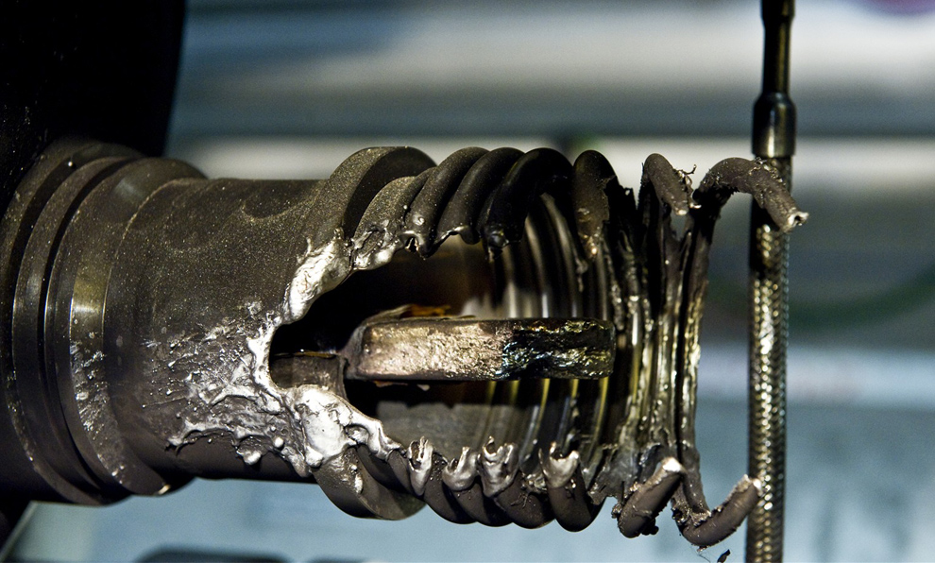
Quench Protection
Quench is biggest threat to LHC dipole magnets
Different types of quench:
Primary quench
Secondary quench: GHe propagation, EM disturbance,..
Quench Protection:
Bypass Diode
Quench Heater
Quenches with destructed magnets:
2008 (~100 destroyed magnets – splice opened)
2021 HWC (1 destroyed magnet - interturn short in coil)
Possible precursor detected 1 month before
Precursor: Oscillation in U_Diode Voltage
Goal: Further precursors?
Critical surface NbTi

Slide 6
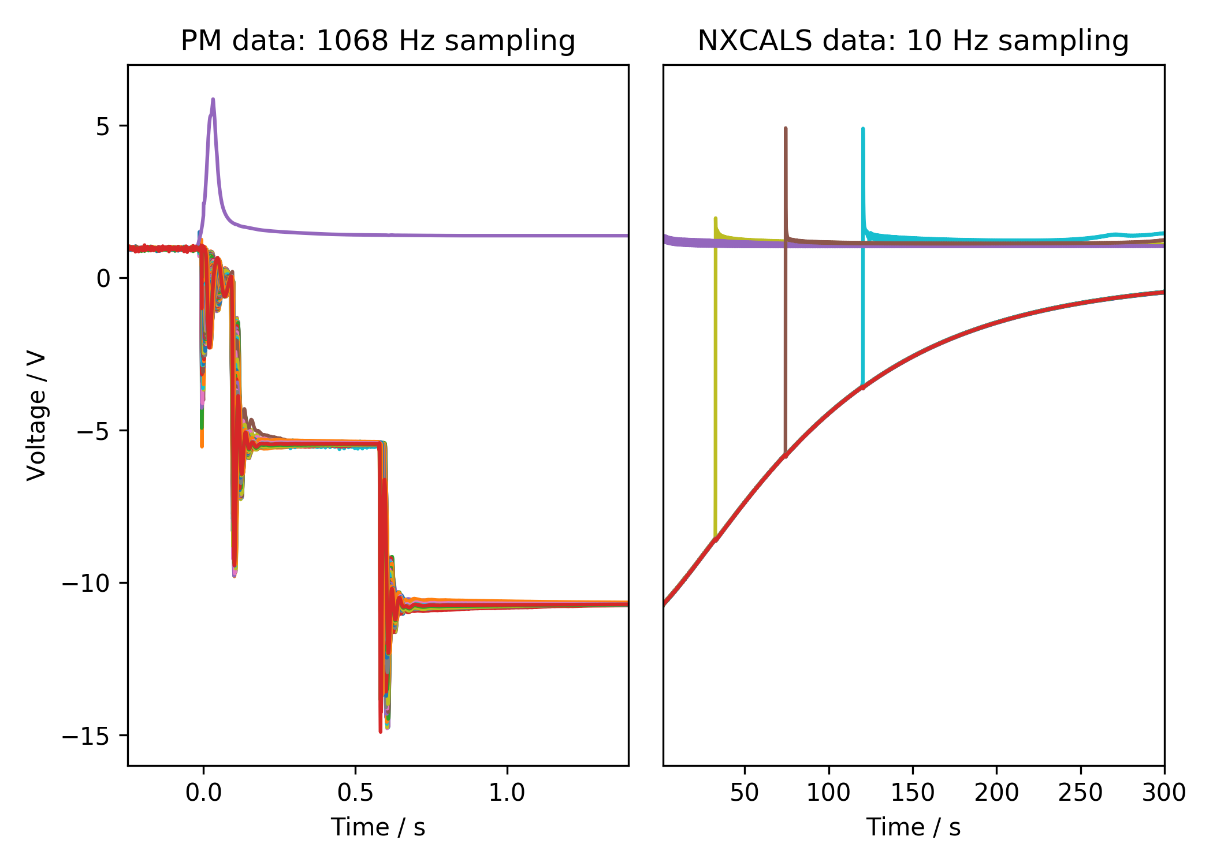
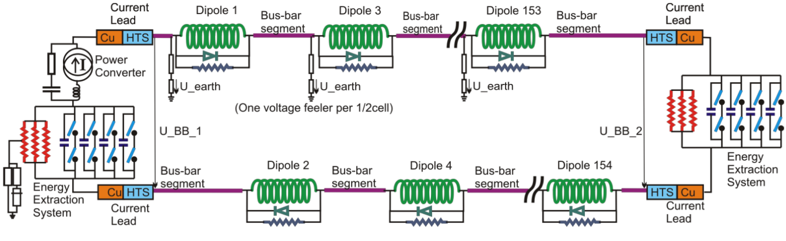
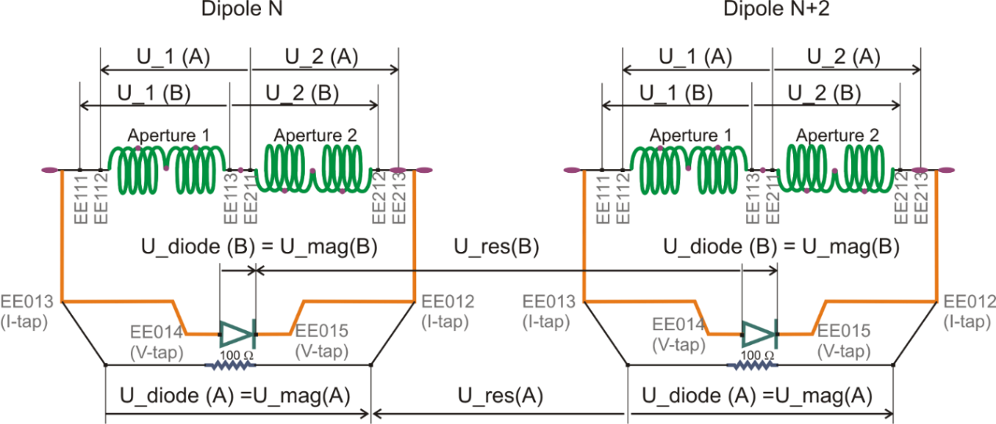
Quench Protection: U-Diode
Interesting area
2nd EE switch off
Secondary quench
1st EE switch off
PC Switch off

Slide 7
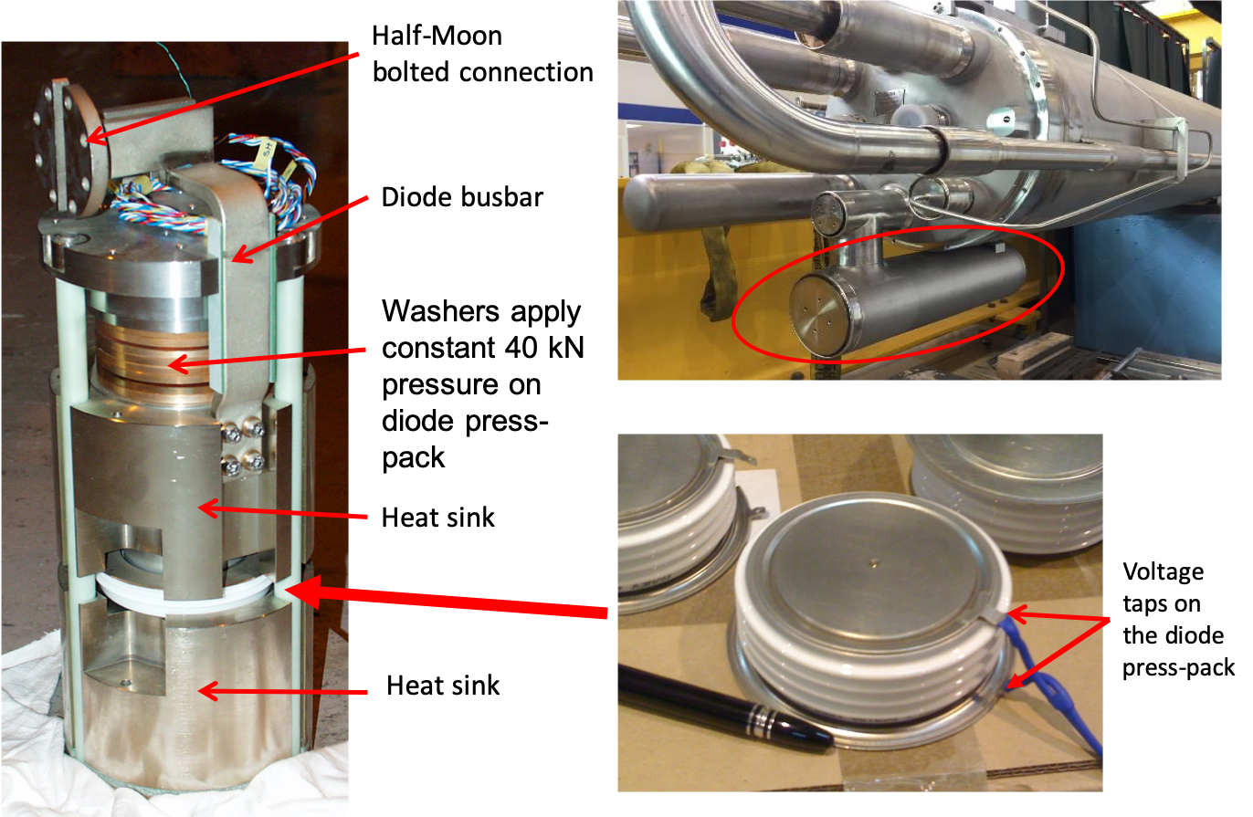
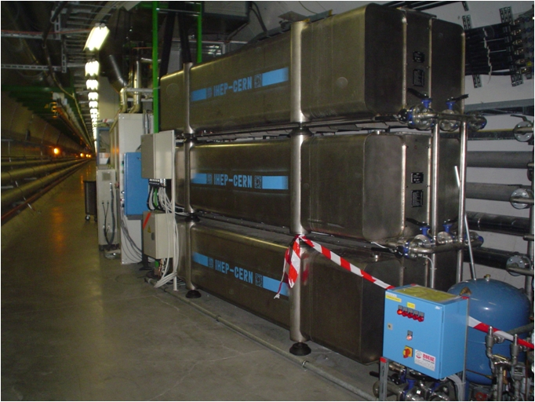
Hardware
Diode
Energy Extraction Resistance

Slide 8
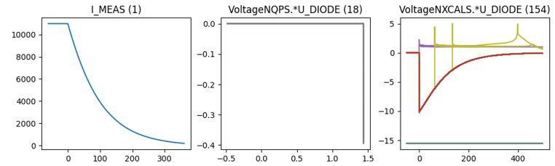
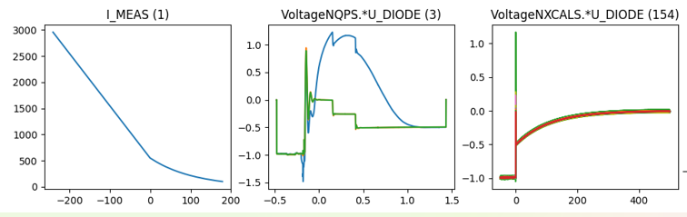
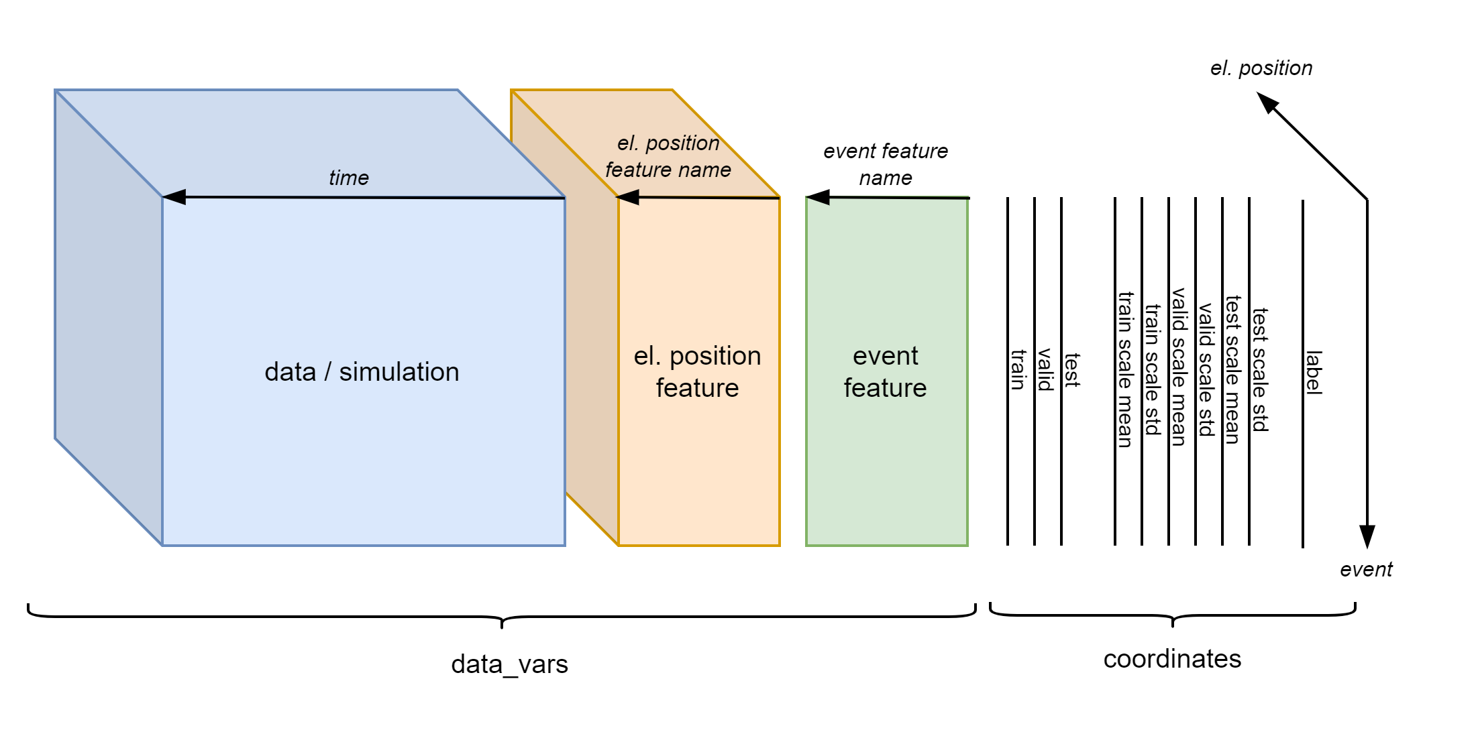
Existing Database Overview
Data overview
Filtered events
 | Signal | 2014-2020 | 2021 | # events
Real Data | U_DIODE_NXCALS | P | P | 867
 | U_DIODE_PM | P | P | 629
 | I_MEAS | P | P | 896
 | U_QSO, U_1, U_2 | P | P | 893
 | I_EARTH_PCNT | P | P | 895
 | I_EARTH | P | P | 629
 | I_HDS, U_HDS | P | P | 896
 | EEUDumpResPM | P | P | 896
Simulations | V(0v_magf*) | P | P | 875
 | I(r1_warm) | P | P | 875
 | V(10,11), V(18,19) | P | P | 875
#events |  | 267 | 629 | 560/896

Slide 9
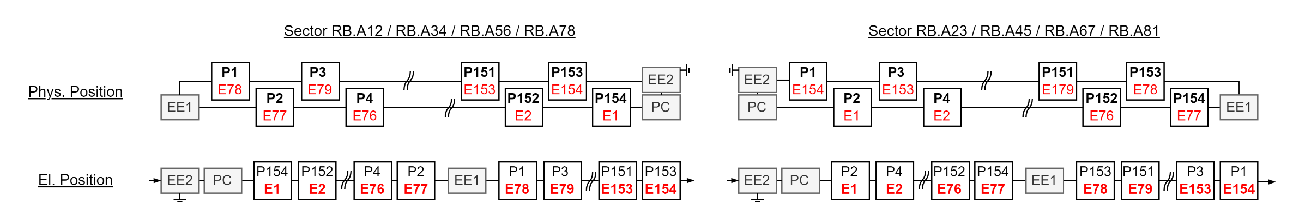
El. Vs Phys. Position

Slide 10
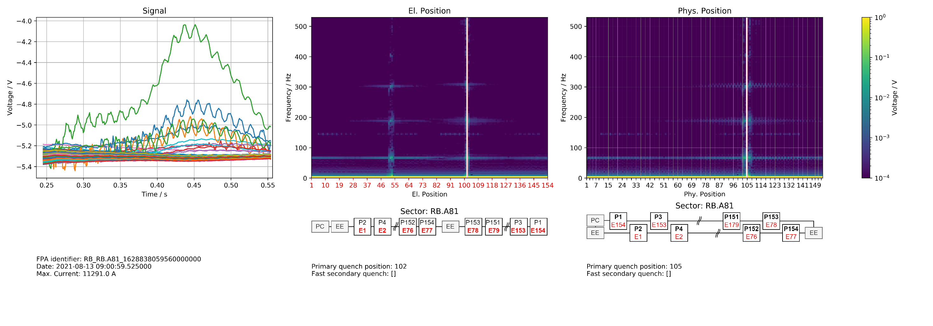
Position Frequency Map

Slide 11
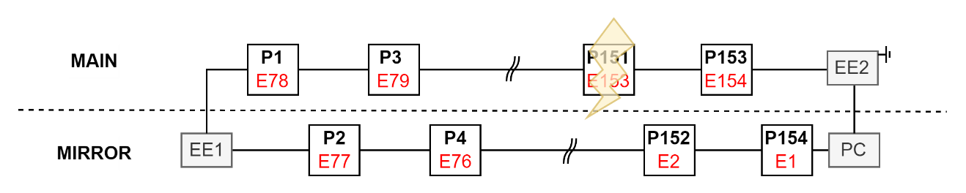
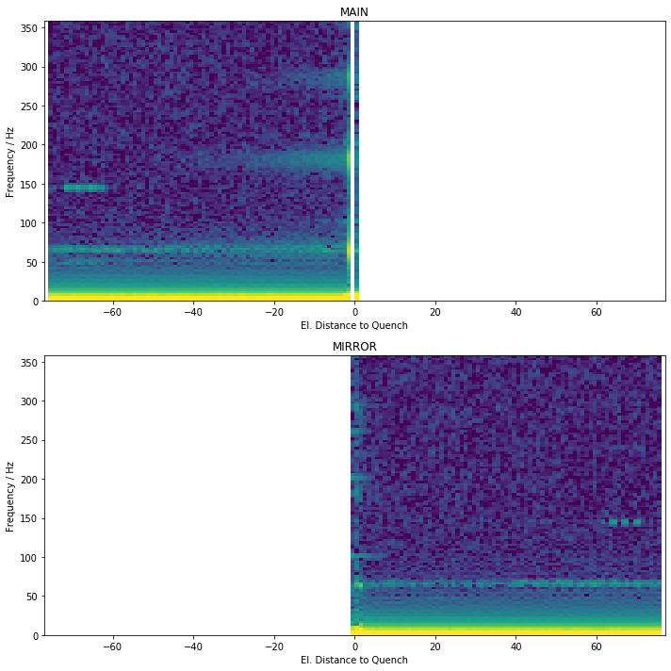
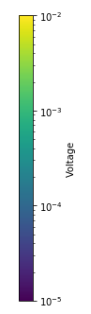
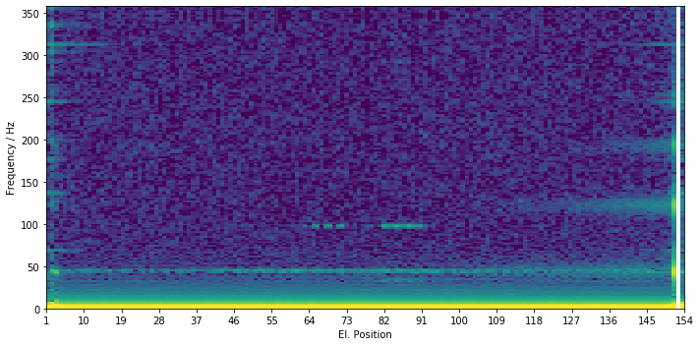
Generalization
To calculate statistics, quench must occur at same position
Not consider events with secondary quenches
Split into
MAIN: Half where quench occurred
MIRROR: Other Half

Slide 12
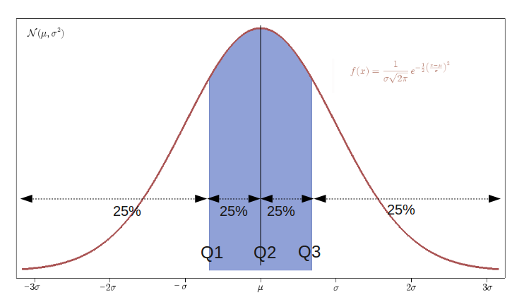
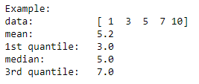
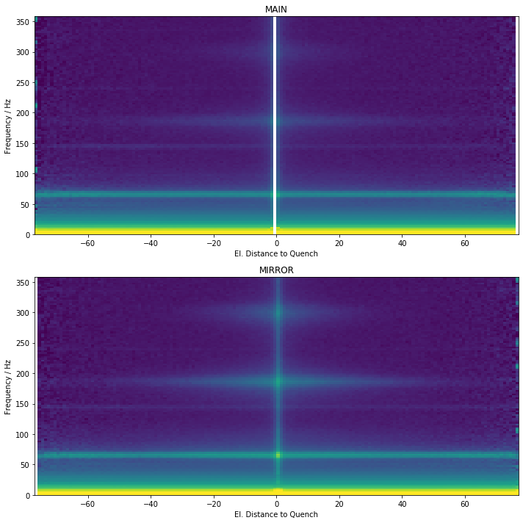
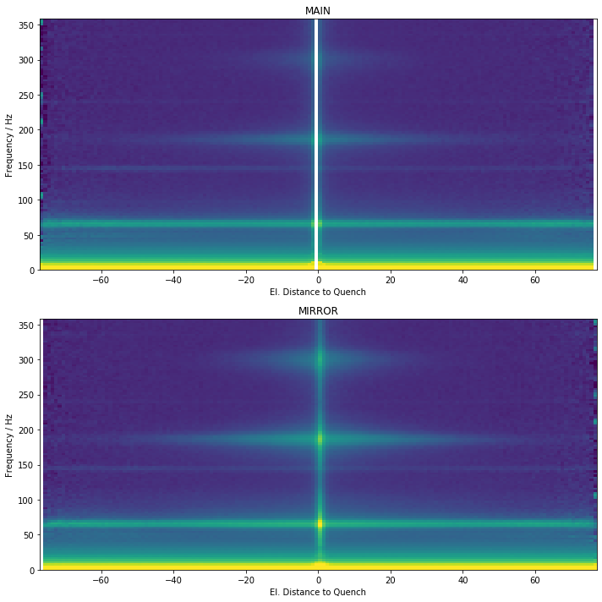
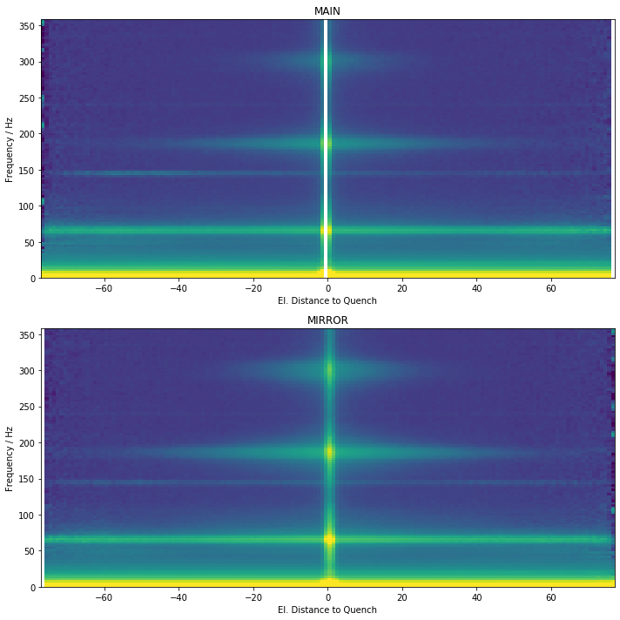
Quantiles
1st quantile
median
3rd quantile

Slide 13
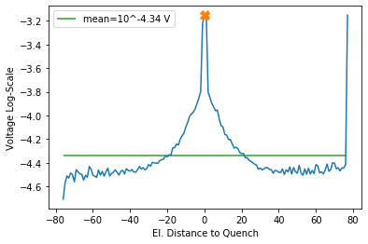
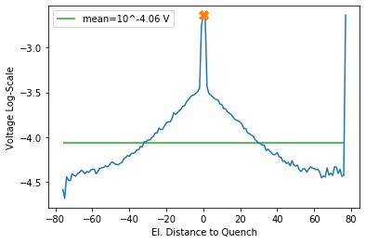
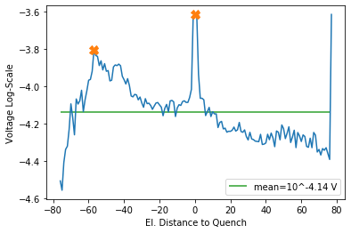
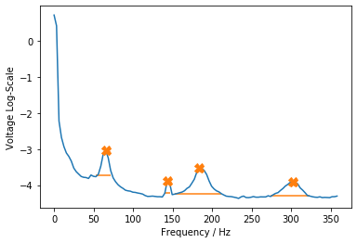
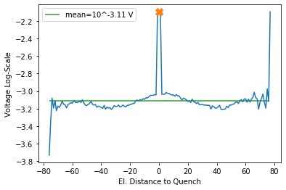
Find Peaks 3rd Quantil
302.1 Hz
183.8 Hz
143.3 Hz
65.4 Hz

Slide 14
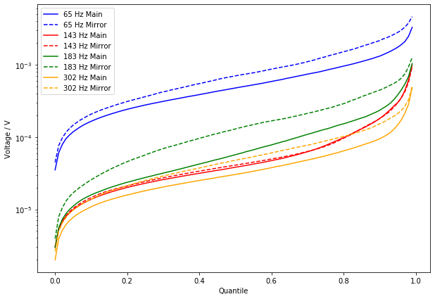




Voltage = f(Quantile)
302.1 Hz
1st Plateau
$${10}^{−3.11} V$$
183.8 Hz
$${10}^{−4.06} V$$
$${10}^{−4.14} V$$
$${10}^{−4.34} V$$
143.3 Hz
3rd Quantil (0.75)
65.4 Hz

Slide 15
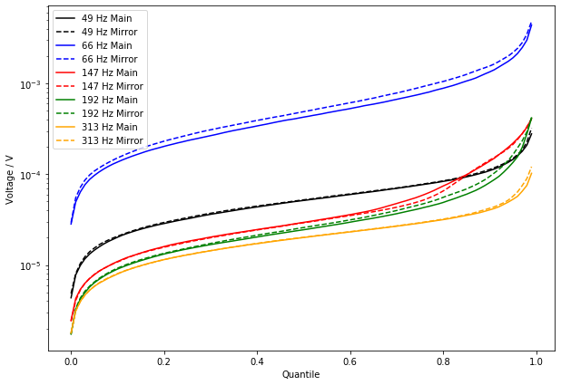
Voltage = f(Quantile)
1st Plateau
2nd Plateau

Slide 16
Non-Negative Matrix Factorization

Slide 17
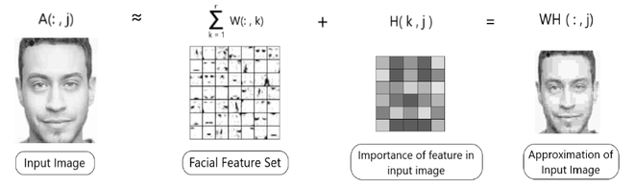
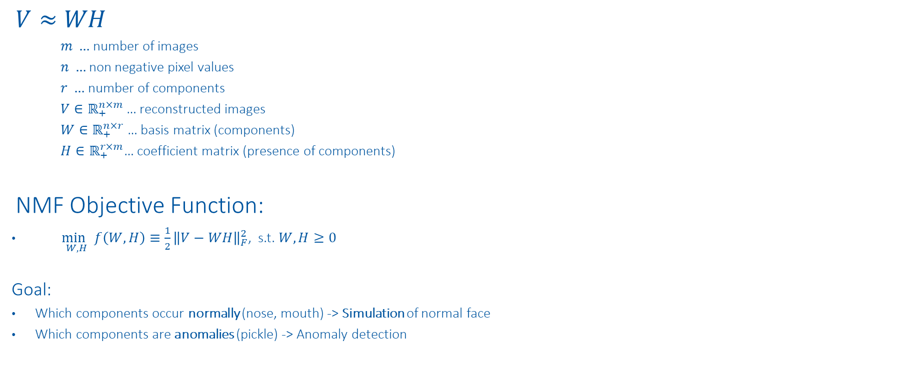
NMF
$$V≈WH$$
$m …$ number of images
$n …$ non negative pixel values
$r …$ number of components
$V∈ℝ_{+}^{n×m}$… reconstructed images
$W∈ℝ_{+}^{n×r}$… basis matrix (components)
$H∈ℝ_{+}^{r×m}$… coefficient matrix (presence of components)
NMF Objective Function:
$\underset{W,H}{\min{ }}f\left(W, H\right)≡\frac{1}{2}{\left\|V−WH\right\|}_{F}^{2}$, s.t. $W, H≥0$
Goal:
Which components occur normally (nose, mouth) -> Simulation of normal face
Which components are anomalies (pickle) -> Anomaly detection
https://www.nature.com/articles/44565
https://proceedings.neurips.cc/paper/2000/file/f9d1152547c0bde01830b7e8bd60024c-Paper.pdf

Slide 18
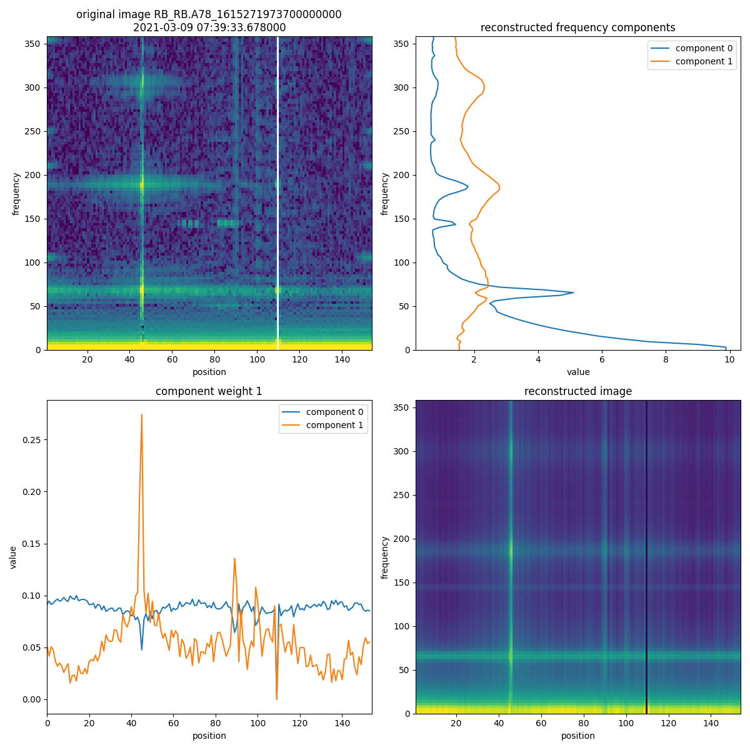
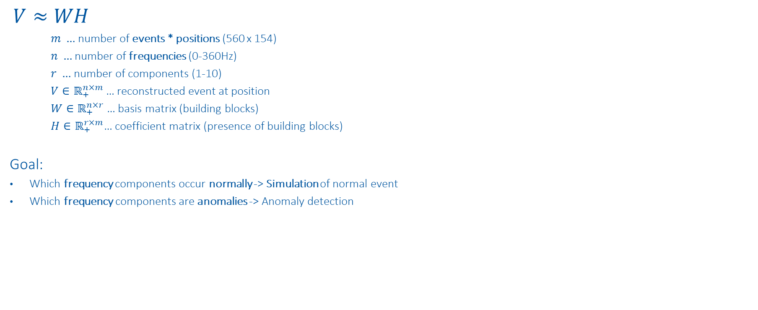
NMF on Position Frequency Maps
$$V≈WH$$
$m …$ number of events * positions (560 x 154)
$n …$ number of frequencies (0-360Hz)
$r …$ number of components (1-10)
$V∈ℝ_{+}^{n×m}$… reconstructed event at position
$W∈ℝ_{+}^{n×r}$… basis matrix (building blocks)
$H∈ℝ_{+}^{r×m}$… coefficient matrix (presence of building blocks)
Goal:
Which frequency components occur normally -> Simulation of normal event
Which frequency components are anomalies -> Anomaly detection
https://www.nature.com/articles/44565
https://proceedings.neurips.cc/paper/2000/file/f9d1152547c0bde01830b7e8bd60024c-Paper.pdf

Slide 19
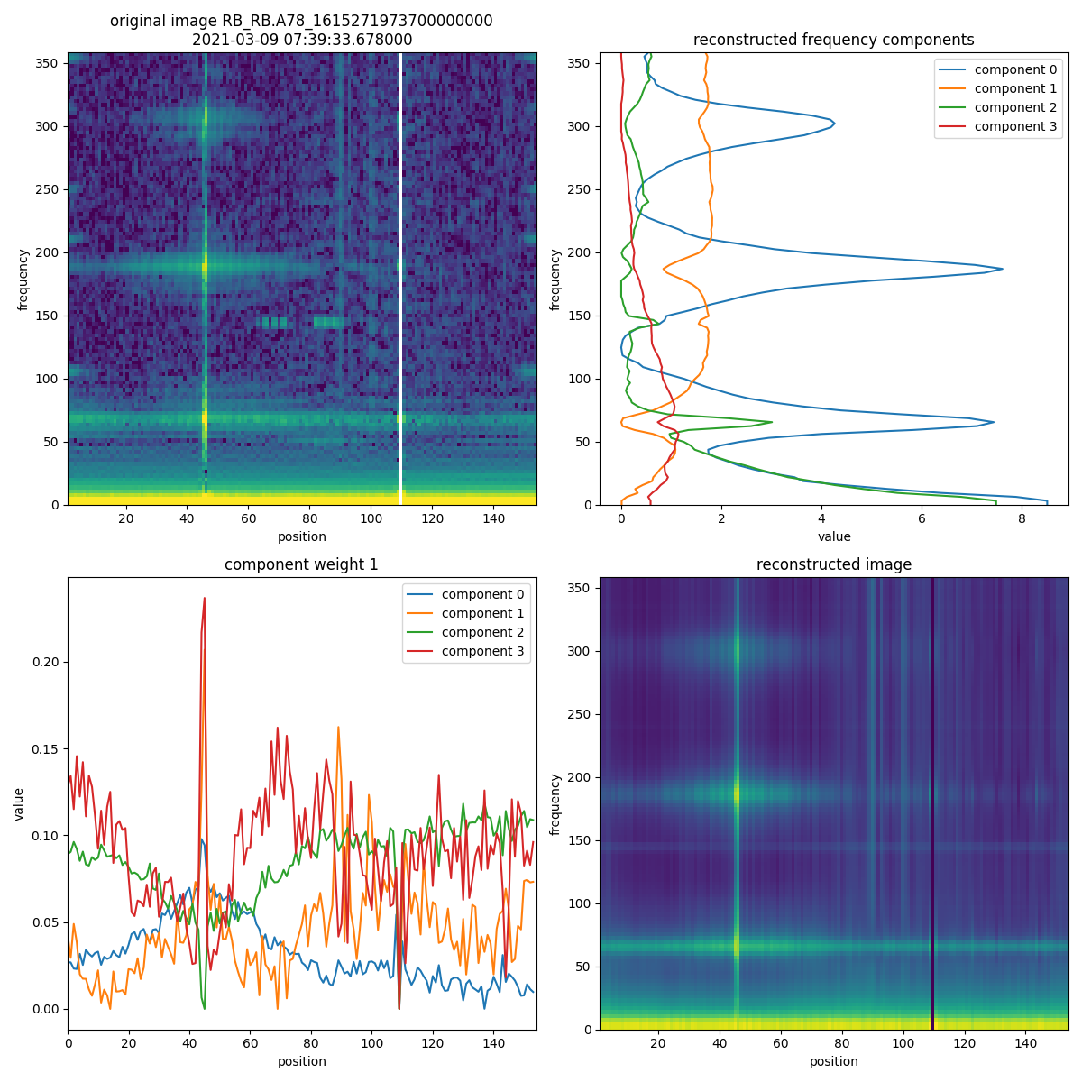
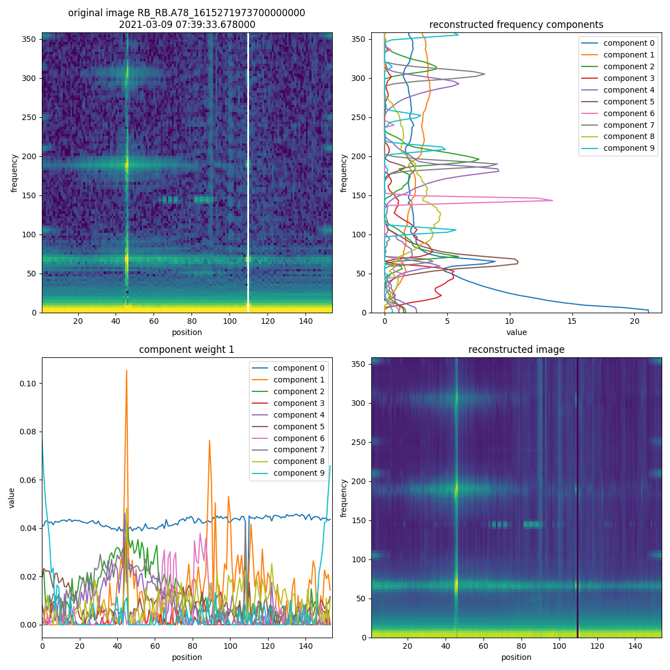
NMF on Position Frequency Maps

Slide 20
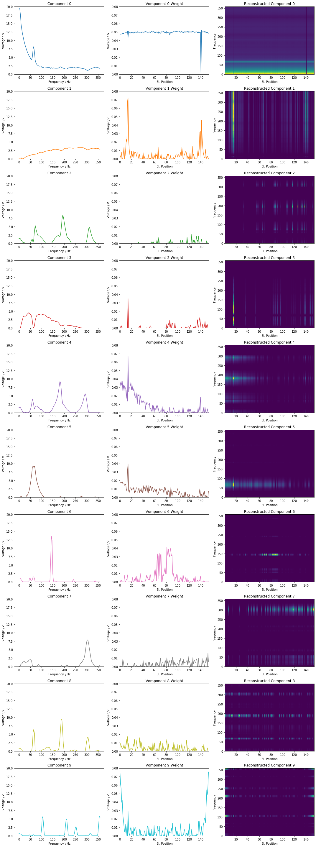
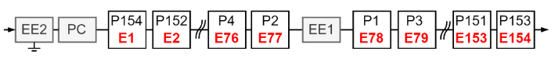
NMF on Position Frequency Maps

Slide 21
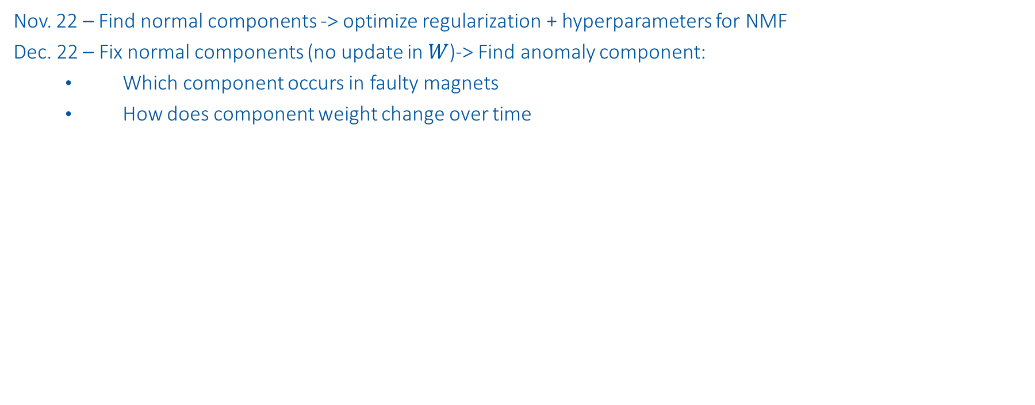
Next Steps
Nov. 22 – Find normal components -> optimize regularization + hyperparameters for NMF
Dec. 22 – Fix normal components (no update in $W$)-> Find anomaly component:
Which component occurs in faulty magnets
How does component weight change over time

Slide 22
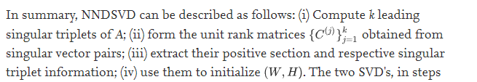
NMF sensitivity analysis
Values to vary:
Initialization:
'nndsvd': Nonnegative Double Singular Value Decomposition (NNDSVD)
'nndsvda': NNDSVD with zeros filled with the average of X
Regularization:
None, L1, L1+L2, L2
On Transformation (H), and Components + Transformation (W + H)
Weight
Shuffle: True, False
*SVD based initialization: A head start for nonnegative matrix factorization

Slide 23
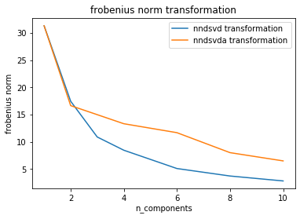
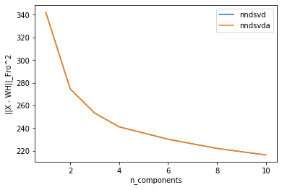
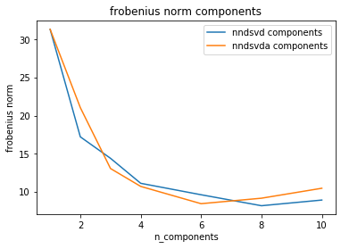
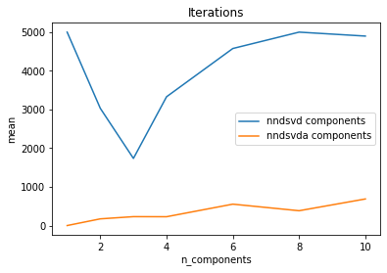
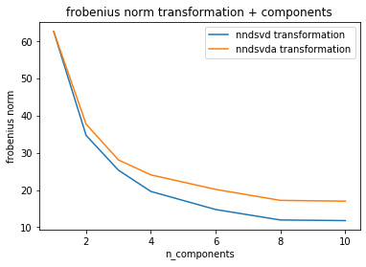
'nndsvd vs 'nndsvda'
Assumption: L1 & L2 regularization, 8 components

Slide 24
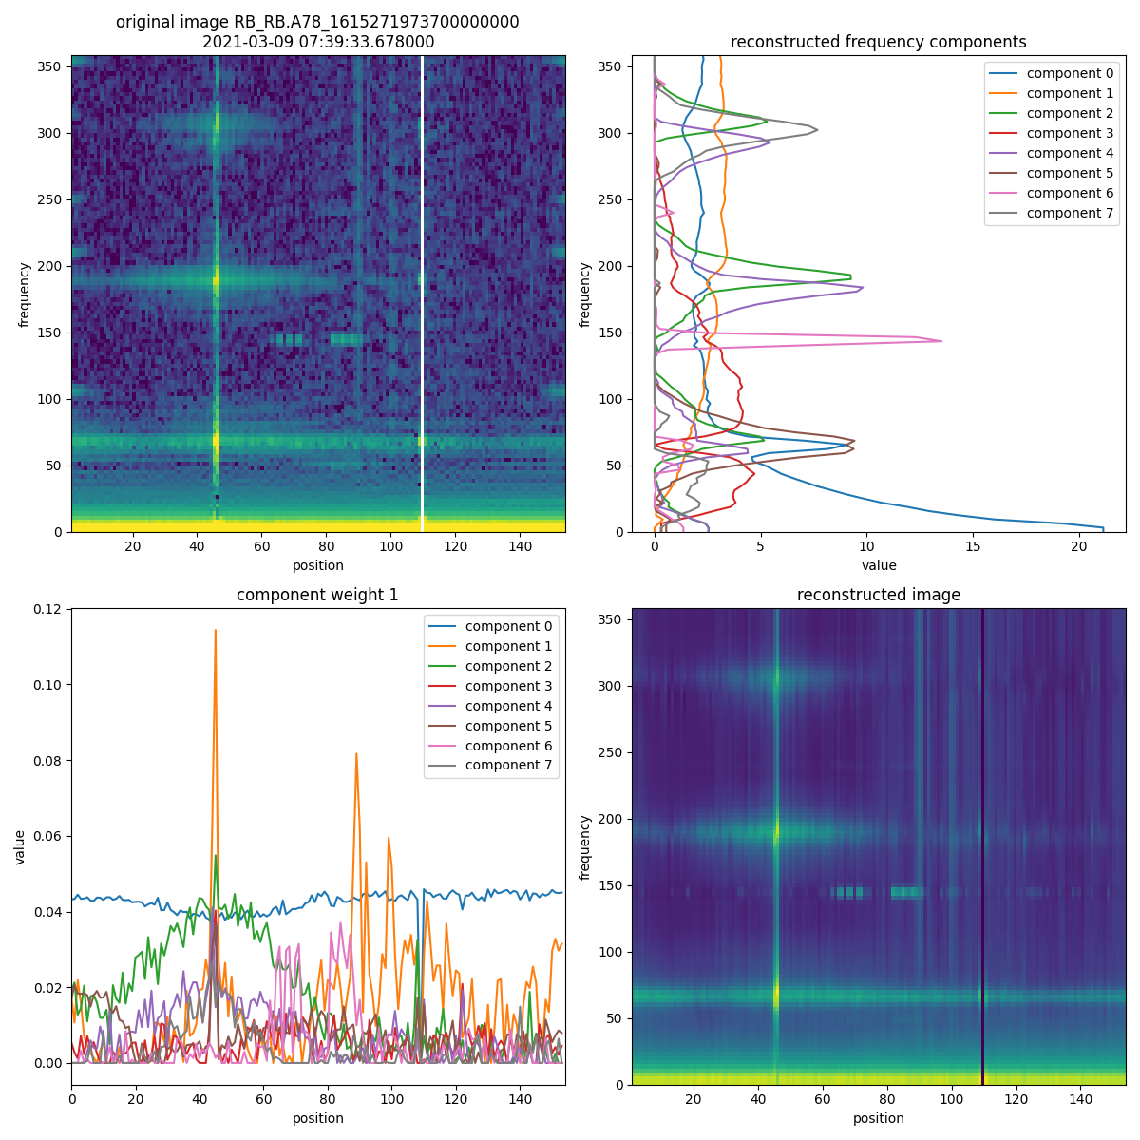

'nndsvd vs 'nndsvda'
Conclusion: Similar result, nndsvda is much faster
nndsvd
nndsvda

Slide 25





Regularization: None, L1, L1+L2, L2
Assumption: nndsvda, On Components + Transformation (W + H)

Slide 26


Regularization: None, L1, L1+L2, L2
Conclusion: L1+L2 lead to best result
None
L1+L2

Slide 27


Regularization: None, L1, L1+L2, L2
Conclusion: L1+L2 lead to best result
L1
L2

Slide 28
Regularization: «»»»»»
Assumption: nndsvda, On Components + Transformation (W + H)

Slide 31






NMF vs. VQ vs. PCA
$$W$$
$$h_{i}$$
$$V≈WH$$
$m …$ number of images
$n …$ non negative pixel values
$r …$ number of components
$V∈ℝ_{+}^{n×m}$… reconstructed images
$W∈ℝ_{+}^{n×r}$… basis matrix (components)
$H∈ℝ_{+}^{r×m}$… coefficient matrix (Presence of components)
Constrains:
Non-Negative Matrix Factorization (NMF):
$H,W$ must contain positive values
Each face is additive combination of parts-based representation
Vector Quantization (VQ) / K-means:
$H$ columns must be one hot encoded
$W$ contains prototype faces
Principal Component Analysis (PCA):
$H$ rows and $W$ columns must be orthogonal
Each face is linear combination of “Eigenfaces”
NMF Objective Function:
$\underset{W,H}{\min{ }}f\left(W, H\right)≡\frac{1}{2}{\left\|V−WH\right\|}_{F}^{2}$, s.t. $W, H≥0$
$$v_{i}$$
https://www.nature.com/articles/44565
https://proceedings.neurips.cc/paper/2000/file/f9d1152547c0bde01830b7e8bd60024c-Paper.pdf

Slide 32
Summary
Interpretation is key:
Check assumptions (e.g. scaling, processing)
Discussion with experts (no ML, algebra, statistics knowledge)
Avoid over-engineering
Check NMF components:
Do I just detect processing features (e.g. interpolation)

Slide 33
Sanity Checks

Slide 34




Kirchhoff
$$−U_{BB_{1}}+U_{BB_{2}}+\sum_{n=1}^{154}{U_{Diode}\left(n\right)}=0$$
Challenges: (1) Sampling (2) Time-alignment

Slide 35


FFT sanity check

Slide 36

Data - Simulation

Slide 37

Next Steps
Further improve plots, according to experts
Add FFT phase to track wave propagation
Find expected oscillation after quench $→$ adjust simulations (PSPICE)
Find oscillation anomalies $→$ precursor of magnet failure?
Possible method to find prototypes in position frequency map: NMF codebooks?

Slide 38



Signal vs. scaled signal
Signal
Scaling: $x_{scaled}=\frac{x−mean\left(x\right)}{std(x)}$
Scaled Signal

Slide 39

Overview of Data-Driven Models
High incorporation of knowledge and context
Data-Driven Models
Manual Feature Engineering
Manual Threshold
Probabilistic
Classic Machine Learning
Automatic Feature Eningeering
Discriminative Deep Learning
Generative Deep Learning
GAN, RNN, ProtoNET
MLP, DCNN, FCN
SVM, Random Forrest, MLP
e.g. Busbar Resistance
e.g. QH Analysis
Fully data driven
Physical Models
Dataset | 1. Feature analysis | 2. Find probabilities/correlations | 3. Finding concepts | 4. Predict parameters | 5. Generate data
1. U Diode Secondary Quench | Oscillation types | Oscillation evolvement
2. U Diode Primary Quench | Oscillation types | Oscillation evolvement | tSNE concepts | Predict sec. quench
3. U Diode Full Quench |  |  |  | Fit simulations | Reconstruct data

Slide 40


1. U Diode Secondary Quench

Slide 41


Manual Feature Engineering
Classification of oscillations after secondary quenches
-2
0
150
-1
1
151

Slide 42


Manual Feature Engineering
2
3
4
2
3
1
min_time, max_time
min_amplitude, max_amplitude
dU_min, dU_max
dstd_max
wiggle_area_pos, wiggle_area_elpos
dstd score: $\frac{mean(wiggle area)}{mean(non wiggle area)}$
Using phys. position, el. position
Different window functions
5
5

Slide 43





1. Oscillation that only propagates electrically
Reason: electric coupling?
2. Oscillation that propagates physically and electrically
Reason: electric coupling through grounding?
Special case: Oscillation in only one magnet
3. Oscillation due to another quench in time window
Reason: coupling of magnets
4. Oscillation due to acquisition
Reason: acquisition
Manual Threshold

Slide 44

Find Probabilities
Wiggle: How does the dstd score evolve in B28L8, compared to other magnets
Probabilistic

Slide 45



2. U Diode Primary Quench
U Diode PM
1st Energy Extraction
Frequency Domain

Slide 46




Sunglass Threshold
Effect threshold to #quenches.
Filter: 20ms moving average

Slide 47




Frequency Domain
Calculate real valued FFT out of scaled input for all magnets.
Scaling: $x_{scaled}=\frac{x−mean\left(x\right)}{std(x)}$

Slide 48


2D-tSNE Frequency Domain
tSNE input: all maximal frequencies per magnet (events, frequency)

Slide 49

2D-tSNE Frequency Domain
tSNE input: all maximal frequencies per magnet (events, frequency)

Slide 50

2D-tSNE Frequency Domain
tSNE input: all maximal frequencies per magnet (events, frequency)

Slide 51









Finding concepts – tSNE overview
Example: Project 2D space to 1D space
2D space
1. Mapping distance between all points to distribution
1D space
Random initialization
Mapping distance between all points to distribution ($σ_{i}=\frac{1}{\sqrt{2}}$)
Distributions of 2D space should be similar to 1D space -> Minimize sum of all KL-divergences
KL-divergence
$$min⁡C$$
Classic Machine Learning

Slide 52





Finding concepts
Find different concepts of different anomalies in data
Example: Concepts in EE plateaus of U_diode PM
2D-tSNE axis 2
2D-tSNE axis 1
Classic Machine Learning

Slide 53
2. U Diode Full Quench

Slide 54


Predict parameters
a.) Neural netlist optimization: Improve simulations with gradient descent
b.) Predict fast secondary quenches with CLIC approach: Use Explainable AI to see what the NN was looking at
Discriminative Deep Learning

Slide 55


Generate data
Can ML generate data faster/more accurate than simulations? Using the same input
Optimization of decoder weights with MSE between real data and simulated data
Advantages:
Decoder can create within seconds, more similar to real data
Detection of anomalies with MSE
Disadvantage: Black box
Generative Deep Learning

Slide 56


Generate data
Can ML generate data faster/more accurate than simulations?
Generative Deep Learning

Slide 57
Discussion
Feature analysis:
Analyze both EE sunglasses, dependent on threshold, also within event
Find probabilities:
How does the dstd score evolve in B28L8, do other magnets evolve similarly?
Find concepts:
tSNE per magnet, look at frequency domain
Predict parameters:
Optimization of magnet parameter, research PSPICE optimization techniques
Generate data:
Simulation data will be improved
Check data integrity: sum of all u diode signals + ee signals should be 0
Also use: UQS0, Voltage feelers, Quench heaters
Genetische Optimierung,

